Slide 1
Regional Workshop on Data Dissemination and Communication
Manila, June 20 – 22, 2012
NIS in Implementing SDMX-based solutions for data exchange though
UNSD/DFID PROJECT ON IMPROVING THE COLLATION, AVAILABILITY AND DISSEMINATION OF NATIONAL DEVELOPMENT INDICATORS, INCLUDING MDGs
Panhara OUKCHAY
National Institute of Statistics
Ministry of Planning, Cambodia
1
Notes:
NIS nowadays is focusing on an open policy for dissemination, so there are more and more data available online/off-line for end users. We have been using several different tools for dissemination, such as
- Redatam, ArcView, CensusInfo(the devInfo adaptation) for Population Census.
NADA-DDI formats for most surveys data documentation.
SuperStar suits which had been used since 2006 and recently used for annual household survey data and later on going expanded for more statistical data.
SDMX-based solutions for NDI data dissemination and transfer to UN Data Portal… etc.

Slide 2
CONTENT
Background
How project works in Cambodia
Challenges and how to overcome?
Future activities
Conclusion

Slide 3
I. BACKGROUND
In 2008, Cambodia and 4 other countries (Bolivia, Liberia, Jordan and Tanzania) has been selected by UNSD to participate in the pilot project
(18 MDG indicators were selected for the cases study)
Finding of the case study in Cambodia:
Lack of data coordination and harmonization in term of statistical standards used within NSS
Lack of encourage use of CamInfo (DevInfo adaptation, was adapted since 2000)
Discrepancies between international and national data for some indicators due to the fact that used different definition/methods an data sources

Slide 4
I. BACKGROUND (cont’)
In 2010, NIS Cambodia signed MOU with UNSD to implement UNSD/DFID project on Improving the collation, availability and dissemination of national development indicators, including MDGs
Three major objectives were setting out:
Improve the coherence among the development indicators produced in Cambodia, through strengthening coordination and collaboration among national data producers by promoting the use of standard definitions, methodologies, and exchange formats and data transfers
Improve visibility to country official statistics at the international level by establishing a single data portal for development indicators at the country level and bringing country data up to international level
Improve statistical literacy among line ministries producing data for development indicators
Notes:
So the main objective of the project is to standardize data and metadata exchange between line ministries and NIS; NIS and UNSD by using SDMX standards.

Slide 5
II. HOW PROJECT WORKS IN CAMBODIA
1. Framework for Implementation:
National Development Indicators framework
In 2000, Cambodia was adopted UN MDGs and in 2003, localized into Cambodian MDGs (CMDGs), specifically consists of 9 goals (the 8 goals plus an additional one focusing on ‘De-mining and Victim Assistance’ with a total of 106 indicators (48 global MDG indicators)
In 2005, Cambodia adapted a Five Year National Strategic Development Plan (NSDP), by synthesizing various prioritize policy documents, including CMDGs, Poverty Reduction Strategy, and Good Governance Action Plan.
Notes:
NSDP 2009-2013 update from the Mid Term Review 2011: Consist of 136 indicators (there are 63 core indicators, and 73 additional indicators)

Slide 6
II. HOW PROJECT WORKS IN CAMBODIA (cont’)
2. Mechanisms for implementation:
Establish National Data Repository: for storing database and disseminating national development indicators, including MDGs by strengthening the existing CamInfo and publishing the CamInfo online including NSDP core indicators
Establish National Development Indicator Registry: for publishing and transferring the selected national development indicators to UNdata portal by using di Datahub tool from DevInfo Support Groups (DSG).

Slide 7
II. HOW PROJECT WORKS IN CAMBODIA (cont’)
Data Output Formats from Line Ministries
Line Ministries
MoEYS
MoH
Line Ministries
EMIS
SPSS 11.5
HMIS
MS SQL Server
Data Files
Data Source
Line Ministry Datasets
Exchange Mechanism
Scripts
DX App SPSS
SQL
Macro/Script
Data Entry Spreadsheets
DevInfo Database
SDMX-ML
Output Formats
Notes:
The line ministries are currently maintaining their data sets in various platforms. The CAMInfo Data Exchange utilities are available to upload the processed data from these platforms into CAMInfo databases. And database administrators are encouraged to customize the data exchange between various platforms to CAMInfo (for example by writing programming scripts).

Slide 8
II. HOW PROJECT WORKS IN CAMBODIA (cont’)
Data Flow from Line Ministries to National Data Repository
Education Ministry
Data Entry Spreadsheets
National
Data Repository
(CamInfo)
Health Ministry
DevInfo Database
Line Ministry
SDMX-ML
Notes:
di Datahub application allows line ministries to exchange data to/from National Data Repository by using various mechanism like email, data storage device, and direct access to National Data Repository.

Slide 9
II. HOW PROJECT WORKS IN CAMBODIA (cont’)
Data Flow from National Data Repository to National Data Registry in SDMX-ML format
National Data Registry (SDMX)
SDMX-ML
National
Data Repository
Publish selected development indicators, including NSDP and CMDGs
Notes:
From the National Data Repository (NDR), SDMX code lists and data files can be generated and published.

Slide 10
II. HOW PROJECT WORKS IN CAMBODIA (cont’)
Data Flow from National Data Registry to UNdata
National Data Registries
UNdata
Burundi
National SDMX Registry
Cambodia
data.un.org
National SDMX Registry
DSD
SDMX-ML
Rwanda
National SDMX Registry
Notes:
The generated SDMX code lists and data files can be made available to the global by consuming them into the respective data hubs (Undata)

Slide 11
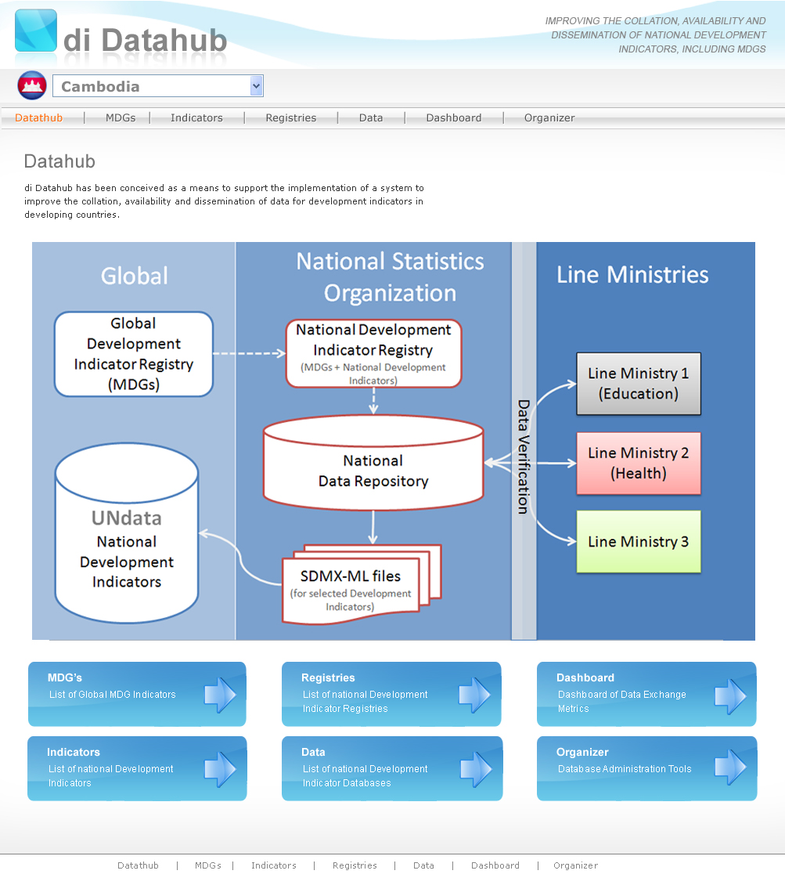
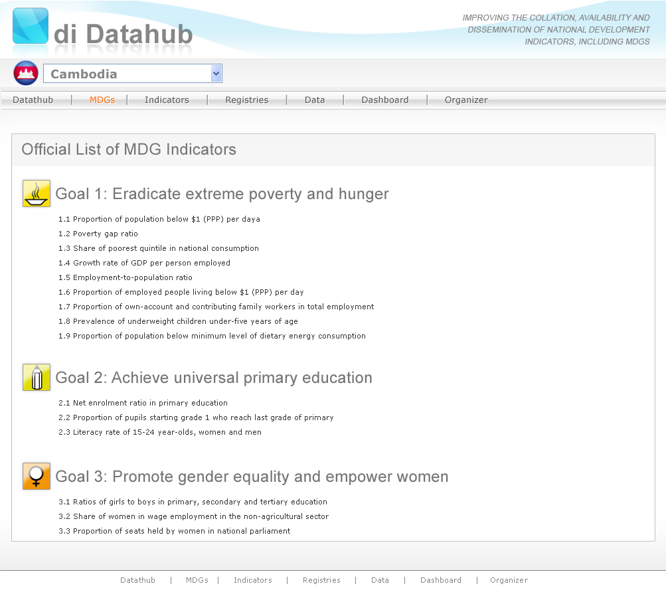
II. HOW PROJECT WORKS IN CAMBODIA (cont’)
di Datahub
Notes:
- di Datahub is a suite of applications based on DevInfo technology and it is an interactive web application. These applications allows to view and manage the operation involved in data exchange. These applications facilitates NIS and line ministries to upload/download data into National Data Repository (NDR) and It also allows to publish SDMX-ML codes list and data files.

Slide 12
II. HOW PROJECT WORKS IN CAMBODIA (cont’)
di Datahub Organizer - NSO
National Institute of Statistics (NIS)
DA
NIS
Global
1. DevInfo DA
Add, edit, delete, print national development indicators and metadata, including MDGs
Import global development indicators, when needed
National
Data Repository
(CamInfo)
Publish
di Datahub Organizer
2. Registry Manager
Automatically publish selected development indicators in SDMX-ML files from the repository via the registry
UNdata
National Development Indicators
National Development Indicator Registry
(MDGs + NSDP Indicators)
3. Upload Data
Upload data to the repository data repository
Transfer to UNdata
SDMX-ML files
(selected development Indicators)
4. Download Data
Download data from national data repository
Notes:
There are two versions of this application one for NSO and the other one for line ministries. The NSO version of the application has features to manage National Data Repository and publish SDMX code lists and data files.

Slide 13
II. HOW PROJECT WORKS IN CAMBODIA (cont’)
di Datahub Organizer - Line Ministries
National Institute of Statistics (NIS)
di Datahub Organizer
Line Ministries
Global
National
Data Repository
(CamInfo)
1. Send Data to NIS
Send data to NIS server via FTP folder then NIS and notify NIS for new updated of data
Publish
2. Download Data
Download data from national data repository
UNdata
National Development Indicators
National Development Indicator Registry
(MDGs + NSDP Indicators)
Transfer to UNdata
SDMX-ML files
(selected development Indicators)
3. Upload Data
Upload data into National Data Repository
Notes:
The Line ministries version of the di Datahub Organizer application has feature to allow LMs to upload data into National Data Repository (but this tool is disable due the quality limitation of data spreedsheet preparing by some LMs; Other enabled features are Send data to NIS which allow LMs to upload data into NIS FTP server with a notification about the data to NIS, and Download Data from National Data Repository.

Slide 14
CAMBODIA SYSTEM SCHEMATIC
Line Ministries
National Institute of Statistics
United Nations
Process DB
National Repository DB
Scripts
CamInfo
Inter’l Datahub
Upload
Option 3:Upload data
Transfer
DES
di Datahub Organizer
NSO
SDMX-ML
SDMX-ML
UN data
Publish
Option 1: Send DES to NIS
DES
FTP
Server
Option 2: Convert DES to
di Datahub Organizer
LM
and send
SDMX-ML
National Registry
Country Data
SDMX-ML
Database
Spreadsheets
XML
Desktop application
Web application
Grey Objects = Existing tools; Yellow Objects = DevInfo development; Blue Objects = UNSD development

Slide 15
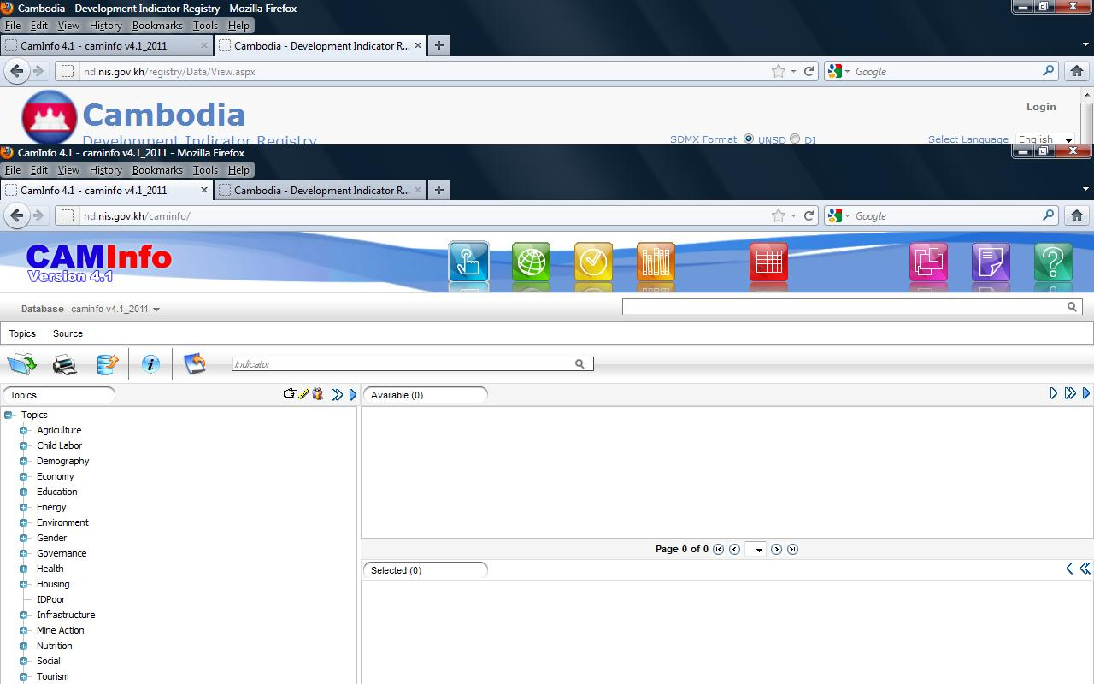

Slide 16
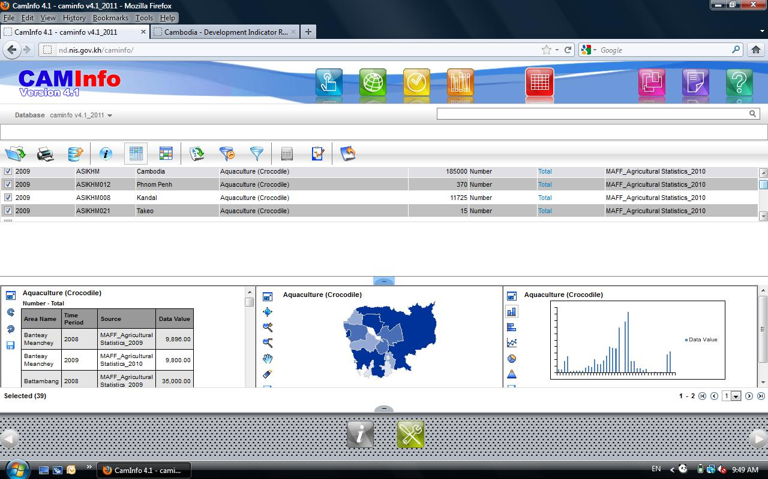

Slide 17
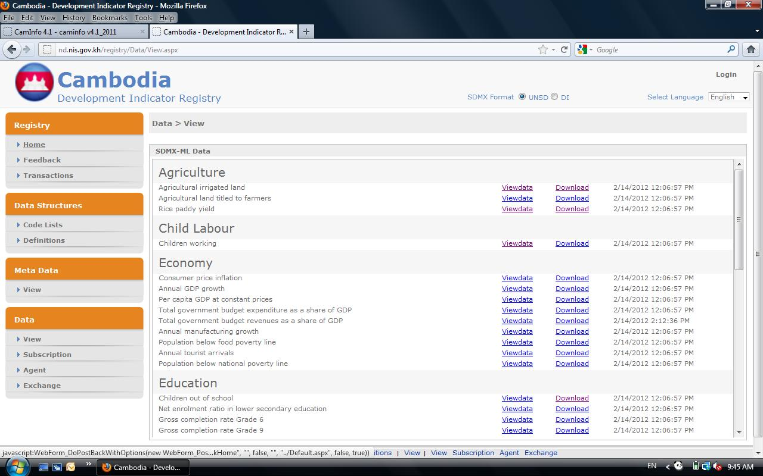

Slide 18
III. CHALLENGES AND HOW TO OVERCOME?
Challenges
Resources :
Limited capacity of statistical staffs both line ministries and NIS
(Statistical skills, knowledge of data, metadata and database)
Physical infrastructure (lack of ICT facilities)
Coordination related to indicators data/metadata collection and compilation
Lack of data availability for suggested indicators
Focal points in line ministries change more often
Lack of documentation for indicators related to NSDP/CMDGs (e.g. definitions, classifications and methodologies)

Slide 19
III. CHALLENGES AND HOW TO OVERCOME? (cont’)
How to overcome?
Series of TWG meetings/consultations with line ministries
Conducted statistical literacy trainings
Focal points network taking place
Metadata Handbook for national development indicators
National data repository (CamInfo online posted by NIS)
Mechanism for data transfer from line ministries to NIS and to the UNdata (National Data Registry and di Datahub Organizer)

Slide 20
IV. FUTURE ACTIVITIES
Continue to conduct the consultations with line ministries in gathering data/information regarding the new set of NSDP-Update indicators for preparing and finalize metadata handbook and updating data for each indicator
Strengthen focal points network in updating the information and discussion about indicator metadata, data quality and review schedule of update/release of indicators
Include new NSDP core and additional indicators in addition to existing indicators to national data repository and publish to national data registry as well as transfer to UNdata (UNSD and NIS review codes given to existing indicators and new codes for additional indicators)
Strengthen CAMInfo database quality and users friendly, such as classifications, disaggregation and data updates to be made available online through NIS website more frequently and look into translation of the core indicator data repository and the user interface into local language-Khmer. (This is suggested to encourage a wider range of local users to access and use the tool comfortably)
Increase training of the use of CAMInfo and di Datahub Organizer to line ministries as well as training on statistical literacy, computer-based statistical analysis.

Slide 21
V. CONCLUSION – CRITICAL FOR SUCCESS
Ownership of database management and in house resources (sustainability)
Strengthened ICT infrastructure (Network, Servers, Website) at NIS
CamInfo plays an important role as the central repository for dissemination of national development indicators
Strong legal framework (Statistics and Sub-decrees to support NSS)
National M&E indicators framework (e.g. NSDP and CMDG)

Slide 22
Thank You!

